Slide 1

What are dependent types and what are they good for?
Stephanie Weirich
ENIAC President's Distinguished Professor of Computer and Information Science University of Pennsylvania

Slide 2

How do we make sense of software?
TYPES

Slide 3
Static typing is by far the most widely used program verification technology in use today

Slide 4
Principle: Static type systems help us create and maintain reliable software, at scale
Notes:
Types are the most practical form of machine checked program verification.

Slide 5
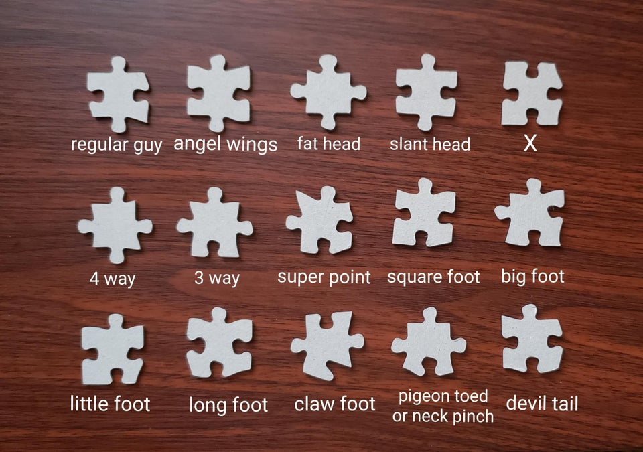
Types let us make distinctions between things that look similar
Types tell us how things should fit together
Improving these leads to better type systems
u/PeranerdErndrerd

Slide 6
How to Design Type Systems
All programs
Programs that do what you want
Has a bug but the type system can’t rule it out
Underlying Problem: Type system can't make the right distinctions
Programs that
type check
No bugs here, but the type system
gets in the way
Underlying problem: Type system can't express why some things
should fit together

Slide 7
How to Design Type Systems
All programs
Programs that do what you want
Has a bug but the type system can’t rule it out
Underlying Problem: Type system can't make the right distinctions
Programs that
type check
No bugs here, but the type system
gets in the way
Underlying problem: Type system can't express why some things
should fit together

Slide 8
Robin Milner's Types
A tool for practical programming

Slide 9
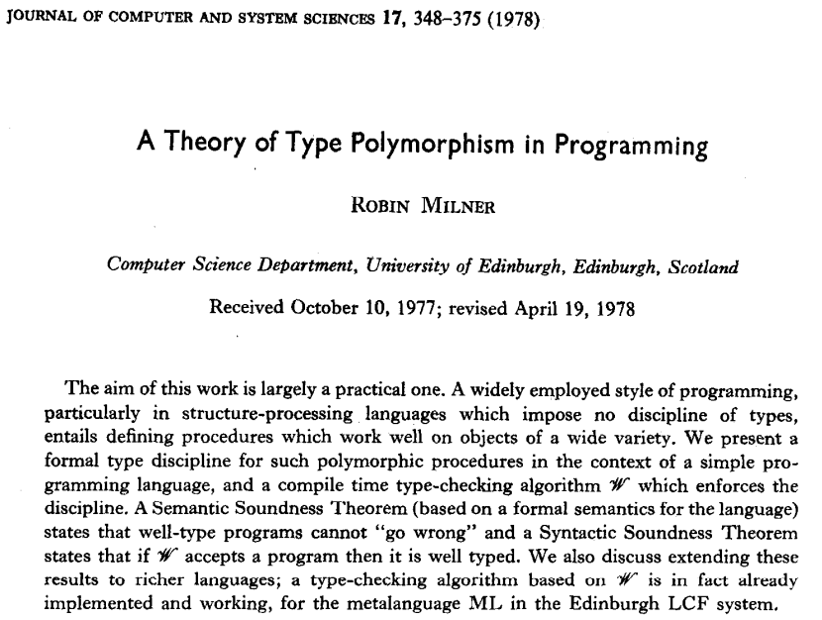

Slide 10
Milner's Contributions
Semantic soundness theorem "Well-typed programs cannot go wrong"
Syntactic soundness theorem Algorithm W that decides when programs are well-typed

Slide 11
Semantic Soundness Theorem: "Well-typed Programs cannot go wrong"
Semantics includes a value "wrong" that corresponds to run-time failure
EXAMPLE: using a function value as a conditional
Type system assigns types to some expressions and semantic values, but "wrong" does not have a type
Semantic Soundness Theorem: if a well-typed expression produces a value in the semantics, then the value has the same type as the original expression
Corollary: If an expression type checks, it cannot evaluate to "wrong"
Notes:
"wrong" is called "undefined" today, could be a segfault
Type system is making a distinction, but the distinction is defined by semantics
"A well-typed program in a strongly typed language has no undefined behavior"

Slide 12
Syntactic Soundness Theorem: Algorithm W
Key language feature is type polymorphism
map : forall a b. (a -> b) -> list a -> list b
Algorithm W calculates principal types (every function has a "best" or "most polymorphic" type)
Complete type inference: no type annotations required!
Syntactic soundness theorem: Algorithm W correctly determines whether programs are well-typed
Foundation for ML and Haskell languages, used to this day

Slide 13
Can we improve on Milner's type system?
Semantic soundness: Well-typed programs cannot "go wrong"
Type system approximates "buggy program" by "going wrong"
"Buggy" defined by the programming language semantics
What if: buggy could be defined by the program itself?
Dependent type systems enable more distinctions
Syntactic soundness: Algorithm W
Types are properties of values, and there is a "best" type
What if: types could express relationships between values?
Dependent type systems enable more programs to type check, but less automatically

Slide 14
Dependent types
Rust
Typescript
Kotlin
Milner
Scala
Swift
Caml
OCaml
F#
Standard ML
GADTs
DataKinds
Haskell
Singletons
TypeFamilies
TypeInType
ATS
F* Everest
Martin-Löf
Pebble Russell
Idris
Trellys
Epigram
Coq
LEGO
Agda
AUTOMATH
LF
Nuprl
CompCert
L∃∀N
1980
1990
2000
2010
2020
Notes:
Dependent types are an old idea. More than 50 years old now.
But, significant advance in terms of programming in the past 20 years.
So why

Slide 15
What are dependent types good for in practical programming?
"Dependent" Haskell
F*
ATS
Trellys
Idris
GADTs
DataKinds
TypeFamilies
Singletons
TypeInType
Epigram
Agda
Notes:
How can practical programmers use them?
Examples in Haskell, but equally valid (and perhaps more viable) in other languages
Focus is NOT on theorem proving
Goal: breadth, not depth
Demonstrate that types can make distinctions and express relationships between values

Slide 16
Dependent Type Systems make application-specific distinctions between values

Slide 17
Access control
data User = Admin | Normal
data Account = Account { userType :: User ... }
-- run code with any user account
doUserStuff :: Account -> IO ()
-- only admin accounts allowed
doAdminStuff :: Account -> IO ()
-- make sure this runs *without* admin privileges
doPublicStuff :: Account -> IO ()

Slide 18
Access conrol
data User = Admin | Normal
data Account (u :: User) = Account { userType :: … }
-- run code with any user account
doUserStuff :: Account u -> IO ()
-- only admin accounts allowed
doAdminStuff :: Account Admin -> IO ()
-- make sure this runs *without* admin privileges
doPublicStuff :: Account Normal -> IO ()

Slide 19
Red-Black Trees
data Tree :: Type where
E :: Tree
NR :: Tree -> A -> Tree -> Tree -- red node
NB :: Tree -> A -> Tree -> Tree -- black node
data RBT :: Type where
Root :: Tree -> RBT
insert :: RBT -> A -> RBT
insert (Root t) x = …
Red nodes have black children
Empty trees are black
Root is black
Both children of a node have same black height
Notes:
Person who knows the system the best is the only person that has to deal with the dependent types

Slide 20
Red-Black Trees
data Tree :: Color -> Type where
E :: Tree Black
NR :: Tree Black -> A -> Tree Black -> Tree Red
NB :: Tree c1 -> A -> Tree c2 -> Tree Black
data RBT :: Type where
Root :: Tree Black -> RBT
insert :: RBT -> A -> RBT
insert (Root t) x = …
Red nodes have black children
Empty trees are black
Root is black
Both children of a node have same black height
Notes:
Person who knows the system the best is the only person that has to deal with the dependent types

Slide 21
Red-Black Trees
data Tree :: Color -> Nat -> Type where
E :: Tree Black Zero
NR :: Tree Black n -> A -> Tree Black n -> Tree Red n
NB :: Tree c1 n -> A -> Tree c2 n -> Tree Black (Suc n)
data RBT :: Type where
Root :: Tree Black n -> RBT
insert :: RBT -> A -> RBT
insert (Root t) x = …
Red nodes have black children
Empty trees are black
Root is black
Both children of a node have same black height
Notes:
Person who knows the system the best is the only person that has to deal with the dependent types

Slide 22
More Examples (Types making distinctions)
Other verified data structures (Merkle Trees, Braun Trees)
Units of measure (2 inches vs. 2cm)
Data provenance (tracking unsanitized inputs)
Refinement types (positive integers, nonempty lists)
Well-scoped and strongly-typed ASTs

Slide 23
Dependent Type Systems can express application-specific relationships between values
Notes:
Type-level computation
Reflection

Slide 24
Data Processing in Python
def read_db(classes_schema, students_schema):
classes_data = load_table(classes_schema, 'classes.json')
student_data = load_table(students_schema, 'students.json')
name = raw_input("Whose students do you want to see:")
students = [ student for class in classes_data \
for student in student_data \
if (class['prof'] == name) \
and (student['id'] in class['students'])]
map(lambda row: print(row['name']), students)

Slide 25
Data Processing in Haskell
read_db classes_schema students_schema = do
classes_data <- load_table classes_schema "classes.json"
student_data <- load_table students_schema "students.json"
name <- putStr "Whose students do you want to see?" >> getLine
let students = [ student | class <- classes_data
, student <- student_data
, class.prof == name
, student.id `elem` class.students ]
mapM_ (\row -> print row.name) students

Slide 26
read_db ::
(HasField "students" (Row schema1) [Int],
HasField "prof" (Row schema1) String,
HasField "id" (Row schema2) Int,
HasField "name" (Row schema2) String) =>
Schema schema1 -> Schema schema2 -> IO ()
read_db classes_schema students_schema = do
classes_data <- load_table classes_schema "classes.json"
student_data <- load_table students_schema "students.json"
name <- putStr "Whose students do you want to see?" >> getLine
let students = [ student | class <- classes_data
, student <- student_data
, class.prof == name
, student.id `elem` class.students ]
mapM_ (\row -> print row.name) students
Notes:
Note: the type of read_db is principal so Haskell can infer it (well, slightly more general than this)
But there is a relationship between the type of classes_schema and the type of classes_data.

Slide 27
Types relate schema to data
load_table :: Schema schema -> FilePath -> IO [Row schema]
-- Schema type describes expected data format
classes_schema :: Schema [ Col "prof" String
, Col "students" [Int]
, Col "course_id" String ]
-- Ensures data is a list of rows in the specified format
class_data = [ "Weirich" :> [1,5,7] :> "CIS 552" :> Nil
, "Zdancewic" :> [1,2] :> "CIS 341" :> Nil ]
Notes:
Constraints display the relationships between
types --- what needs to be present in the two
tables?
Don't need to completely sacrifice type inference
in presence of fancy types (in Haskell)
And Milner likes that
: [ Row [ Col "prof" String
, Col "students" [Int],
, Col "course_id" String ] ]

Slide 28
Types describe interfaces
Informal specification of Web API
The endpoint at /users expects a GET request and returns a list of JSON objects describing users, with fields name, email, and registration_date,
or a single user specified by an id number
data User = User { name :: String,
email :: String,
registration_date :: Day }
type UserAPI = "users" :> Get '[JSON] [User] :<|>
"users" :> Capture "id" Int :> Get '[JSON] User
Notes:
Server: Ensures web application provides exactly this functionality
Client: Receives values of the associated type

Slide 29
Haskell Servant Library
API type expresses relationship between the server and client applications
Server: Ensures web application provides exactly this functionality
server :: Server UserAPI
server = getUserById :<|> return users
getUserById :: Int -> Handler User
getUserById id = if id < length users then return (users !! id) else throwError err404
Client: Receives values of the associated type
getUsers :: ClientM [User]
getUser :: Int -> ClientM User
getUser :<|> getUsers = client userAPI

Slide 30
Automatic marshalling
Server and client need to convert between type User and JSON formatted strings.
Dependent Types track relationship between User and its generic representation.
data User = User { name :: String,
email :: String,
registration_date :: Day } deriving (Eq, Show, Generic)
instance ToJSON User -- uses Aeson library to derive
instance FromJSON User -- based on Generic rep of type

Slide 31
More examples (Types expressing relationships)
Other rich interfaces (printf, regexp matching)
Type-based reflection (Dynamic types, type-indexed maps, datatype-generic programming)
Protocols, i.e. interfaces with effects (state machines, session types, algebraic effects)
Improved performance (Express low-level memory layouts, eliminate dynamic array bounds and tag checks, verify C code)
Embedded Domain-Specific Languages (Hardware/FPGAs, Music, Contract Law, etc.)

Slide 32
The Future of Dependent Types in Practical Programming
Distinctions for describing resource usage: integration of linear and dependent types (already in Agda, Idris)
New approaches to type and proof inference: SMT solvers (LiquidHaskell), tactic languages (Mtac2), algorithms (QuickLook)
More type-directed program development: the type system as a guide either in the IDE or for automatic synthesis
More flexibility in working with coercions and isomorphisms: new semantics for dependent types (HoTT, Higher-Inductive Types)

Slide 33
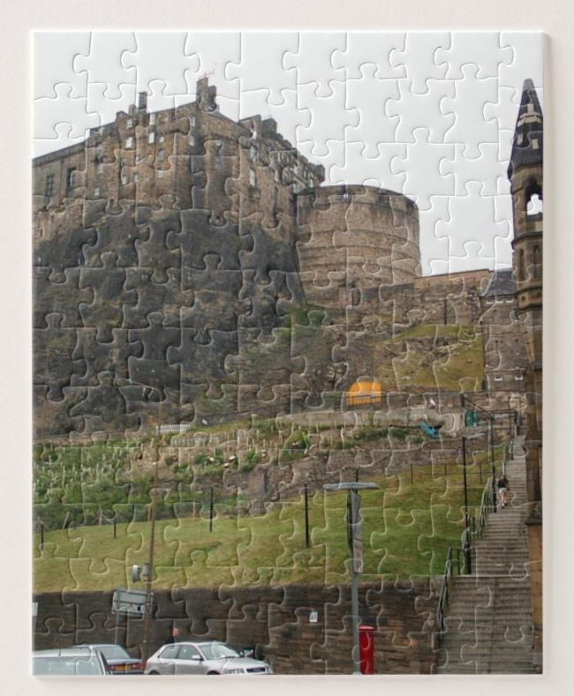
Summary: Static types provide practical benefits to programmers. Dependent types provide practical benefits to type systems.
Making application-specific distinctions between values
Expressing application-specific relationships between values

Slide 35
Type-safe printf
-- Number and types of arguments to printf determined by
-- format string
printf : (s : String) -> interpFormatString s
printf s = …
interpFormatString "hello" = String
interpFormatString "hello %s" = String -> String
interpFormatString "%d: %s" = Int -> String -> String
Idris
Notes:
Point out relationship between string value and type of printf

Slide 36
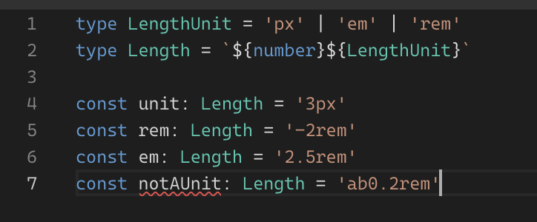
Different types of text
Typescript
https://twitter.com/tesseralis/status/1530346544137789443
Notes:
This is basically an example of refinement types

Slide 37
Associative Maps: statically track domain set
ghci> let m = M.fromList [ ("haskell" , "lazy") , ("javascript", "eager")] ghci> m ! "haskell" "lazy" ghci> m ! "python" "*** Exception: key is not in the map
ghci> let m = SM.fromList [ ("haskell" , "lazy") , ("javascript", "eager")] ghci> m ! "haskell" "lazy" ghci> m ! "python" "*** Exception: key is not in the map

Slide 38
Why types?
Static typing is by far the most widely used program verification technology in use today
Type errors identify bugs!
Types specify code. They say (to people) what functions do
foozle :: Gizmo -> Gadget -> Contraption
Types help program development (IDEs)
Types help software maintenance & refactoring

Slide 39
What are dependent types?
Origin: Foundation for automated reasoning and formalized logic
Martin-Löf Dependent Type Theory as a foundation for mathematics ()
ML language designed for scripting proof search (LCF)
Now: Mainstream programming and proving
Statically-typed languages commonplace and pervasive
Dependent Type Theory provides inspiration for type system extension
Proof assistants and formalized reasoning seeing wider adoption

Slide 40
What are the features of dependent type systems?
Type-level computation
We can use the type system to implement a domain-specific compile-time analysis
Indexed types
Type indices can constrain values and guide computation
Double-duty data
We can use the same data in types and at runtime
Equivalence proofs
Type checker must reason about program equivalence, and sometimes needs help

Slide 41
Domain-specific libraries

Slide 42
New perspectives on language design
Milner 1978: programmers never write types
Algorithm W is complete and works without guidance
New perspective: type annotations are useful in code
(Machine-checked) documentation about what the code does
Seed for remarkably effective program synthesis
Hints for program verification

Slide 43
Dependent type myths

Slide 44
Dependent Haskell
Key idea: Use features from logic to inspire the design of a programming language
Benefit: Developers can create correctness proofs while they program
My role: Collaboration with designers of Haskell programming language
Impact: Community of Haskell programmers who use these features everyday(?!)
Stephanie Weirich
with Richard Eisenberg (Penn,Tweag/IO), Simon Peyton Jones (Epic Games), Joachim Breitner, Harley Eades III (Augusta), Antoine Voizard, and Pritam Choudhury

Slide 45


